Slide 1
lntelligent chatbot to answer queries pertaining to various Maintenance Processes within Substation
PIP4004 University Project
Review-0
Batch Number:
Under the Supervision of,
Prof.Sandhya L
Assistant Professor
School of Computer Science and Engineering
Presidency University
Roll Number | Student Name
ROLL NUMBER | STUDENT NAME
20211CST0043 | V MANJUNATH REDDY
20211CST0050 | RAKSHITHA M
20211CST0002 | JDVSS MALLIKA
20211CST0029 | P HARI NARAYANA
Name of the Program: BTECH
Name of the HoD: Dr.SairaBanu Atham
Name of the Program Project Coordinator: Dr.H M Manjula
Name of the School Project Coordinators: Dr. Sampath A K / Dr. Abdul Khadar A / Mr. Md Ziaur Rahman

Slide 2
Content
Problem Statement
Analysis of Problem Statement
Timeline of the Project
References

Slide 3
Problem Statement
Organization: KG info systems pvt ltd
Category (Hardware / Software / Both) :software
Problem Description: A chat bot which can interpret the customer complaints or queries, search the DB for resolution and in case new solution found, hand it over to support staff. Based on the conversation b/w customer and staff, update the DB, be prepared to handle similar queries in future.
Difficulty Level: complex

Slide 4
Analysis of Problem Statement
Technology Stack Components:
Frontend:
React.js
HTML, CSS
JavaScript
Backend:
Node.js with Express.js
Python/Django
MongoDB/MySQL
Firebase
BERT (Bidirectional Encoder Representations from Transformers)

Slide 5
Analysis of Problem Statement (contd...)
Software and Hardware Requirements:
Operating System: Windows 10, macOS, Linux
Frameworks: React.js, Node.js/Express.js
Database: MongoDB, MySQL
Maps & Geolocations APIs: Google Maps API, OpenStreetMap
Version Control : GitHub/GitLab
BERT (Bidirectional Encoder Representations from Transformers)

Slide 6
Analysis of Problem Statement (contd...)
Objective: Develop a chatbot that:
Interprets Customer Queries/Complaints: Understands and processes the text input from customers.
Searches for Resolutions: Looks up existing solutions in a database to address the customer’s issue.
Handles New Issues: Routes unresolved issues to support staff.

Slide 7
Analysis of Problem Statement (contd...)
Updates the Database: Based on interactions and solutions provided, updates the database for future reference.
Learns and Adapts: Improves over time by learning from past interactions and solutions.

Slide 8
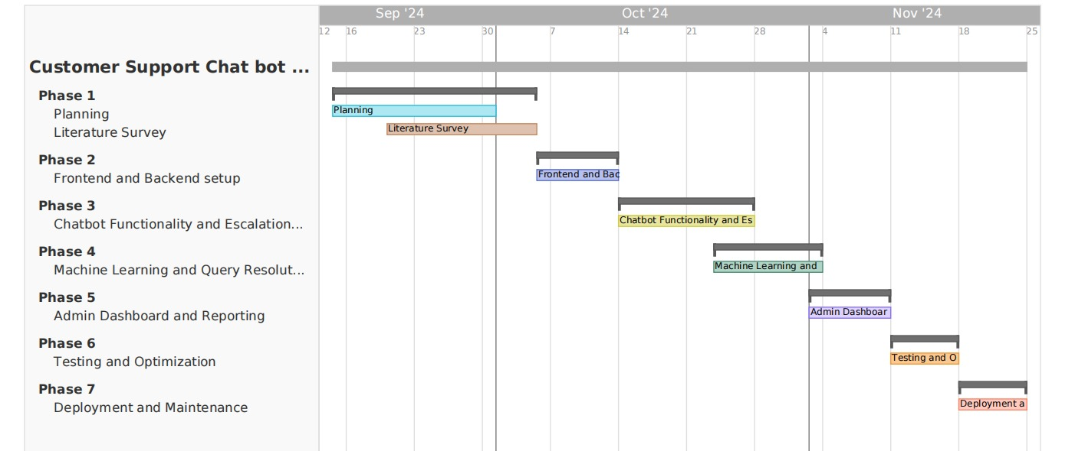
Timeline of the Project (Gantt Chart)

Slide 9
References (IEEE Paper format)
[1] Dialogflow Documentation | Google Cloud https://cloud.google.com/dialogflow/docs
[2] R Khan, A Das - A complete guide to getting started with chatbots, 2018 – Springer
[3] Evaluating and informing the design of chatbots
M Jain, P Kumar, R Kota, SN Patel - Proceedings of the 2018 Designing …, 2018 - dl.acm.org
[4] Chatbots for learning: A review of educational chatbots for the Facebook Messenger

Slide 10


